Slide 1
IT Security and Penetration Testing
Chapter 11
Denial-of-Service Attacks

Slide 2
Objectives
Define a denial-of-service (DoS) attack
Describe causes of DoS attacks
Describe several varieties of DoS attacks
Computer Security and Penetration Testing

Slide 3
Objectives (continued)
Define a distributed denial-of-service (DDoS) attack
Discuss some known DoS and DDoS attacks
Describe ways to prevent DoS and DDoS attacks
Computer Security and Penetration Testing

Slide 4
Causes of DoS Attacks
Some major network defects and vulnerabilities
  Vulnerability of the network architecture
  Vulnerability of a specific server system architecture (Intel x86, AMD Opteron, etc.)
  Defects and bugs in the operating system or software
  Holes present within system security
Some vulnerabilities cannot be closed by patching
  Because there is an inherent bandwidth limit
Computer Security and Penetration Testing

Slide 5
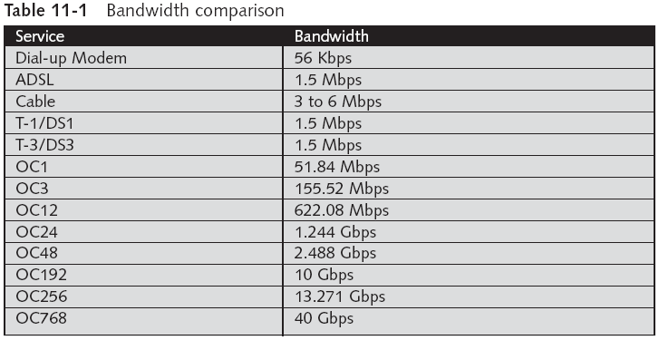
Causes of DoS Attacks (continued)
Computer Security and Penetration Testing

Slide 6
Types of DoS Attacks
See Figure 11-1
  X axis = Flood attacks or software attacks
  Y axis = Isolated attacks or distributed attacks
  Z axis =Voluntary or involuntary, on the part of the systems administrator
Computer Security and Penetration Testing

Slide 7
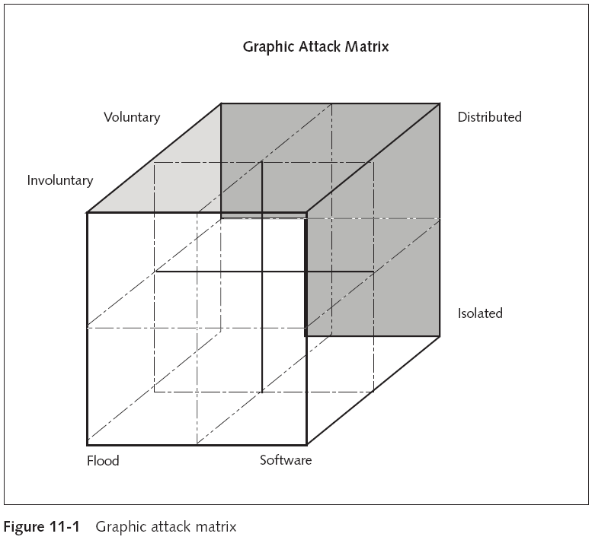
Computer Security and Penetration Testing

Slide 8
Voluntary DoS
Occurs when the sysadmin has allowed the system
  To perform a variety of services without considering the system’s limitations
Computer Security and Penetration Testing

Slide 9
Involuntary DoS
Takes place regardless of preparation and readiness by the sysadmin
Computer Security and Penetration Testing

Slide 10
Flood Attacks
Consume the limited resources of a computer or a network
  By transmitting a large number of packets as quickly as possible
A flood attack can occur under the following conditions:
  Sending connection requests
  Consuming the bandwidth
  Using your own resources
  Consuming others’ resources
Computer Security and Penetration Testing

Slide 11
Flood Attacks (continued)
Sending Connection Requests
  Target or victim receives a large quantity of connection requests
  Attacker is probably using a spoofed IP address
Consuming Bandwidth
  All of a network’s available bandwidth is consumed by sending a large number of packets
Computer Security and Penetration Testing

Slide 12
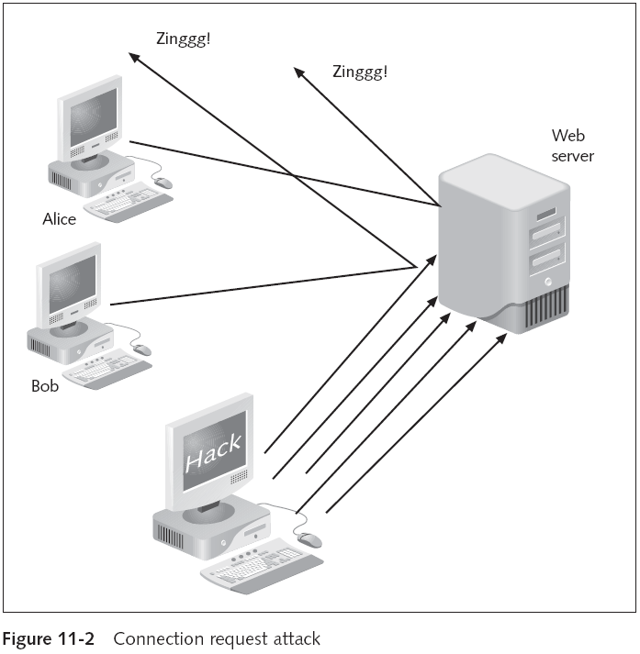
Computer Security and Penetration Testing

Slide 13
Flood Attacks (continued)
Using Your Own Resources
  Hacker uses forged UDP packets to connect the echo service on one computer
    To a service on another computer
  Response for this packet will automatically be sent to the computer whose IP address the hacker is using
Computer Security and Penetration Testing

Slide 14
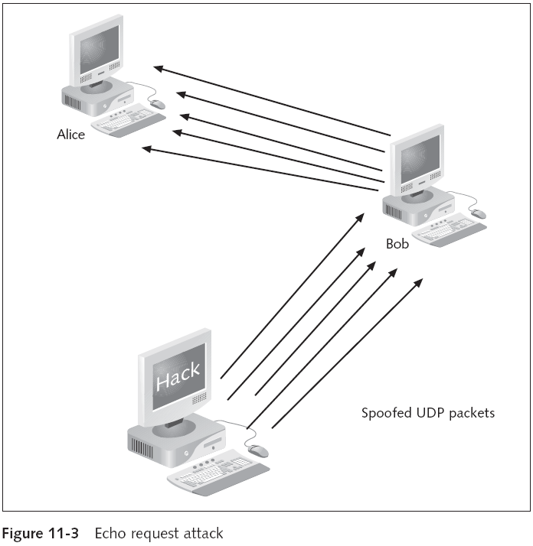
Computer Security and Penetration Testing

Slide 15
Flood Attacks (continued)
Consuming Other’s Resources
  Hacker may be able to consume data structures
    Simply writing a program or a script that replicates itself
  Hackers also attempt to consume disk space
    By using any feature that allows data to be written to a system’s hard disk
  Hacker may be able to lock an account by executing a certain number of failed attempts to log in
Computer Security and Penetration Testing

Slide 16
Software Attacks
Exploit the existing software weaknesses
Effect is either degraded performance or crashes on the victim server
Hackers generate a small number of carefully malformed packets to exploit known software bugs
  Bugs allow hackers to change or damage configuration files
Computer Security and Penetration Testing

Slide 17
Software Attacks (continued)
Ping of Death
  A historical DoS attack in which the hacker uses the Ping utility to acquire access to a system
  Hacker sends a packet larger than 64 KB to the target computer
  Target system may crash or restart
  Most legitimate Ping utilities do not allow you to send a ping of more than 64 KB
  You can use Apsend to send an oversized packet
Computer Security and Penetration Testing

Slide 18
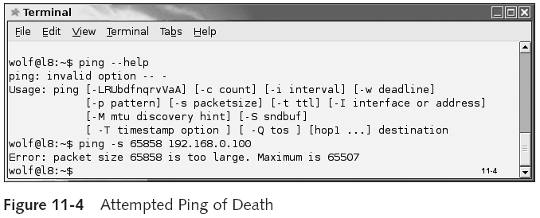
Software Attacks (continued)
Computer Security and Penetration Testing

Slide 19
Software Attacks (continued)
Ping of Death (continued)
  You can block pings on your firewall
  Almost all operating systems have been patched to deflect this attack
DNS Service Attack
  Domain Name Service (DNS)
    Database that maps domain names to IP addresses
  Two kinds of attacks are related to the DNS service: DNS spoofing and DNS overflow
Computer Security and Penetration Testing

Slide 20
Software Attacks (continued)
DNS Service Attack
  DNS Spoofing
    Users or customers may be redirected to Web sites other than their intended destination
    Should not be confused with phishing
    May lead to customers giving their account information to hackers
  DNS Overflows
    May happen when there is a failure to check and verify the length of the host name
    Could be used to gain superuser access to the system
Computer Security and Penetration Testing

Slide 21
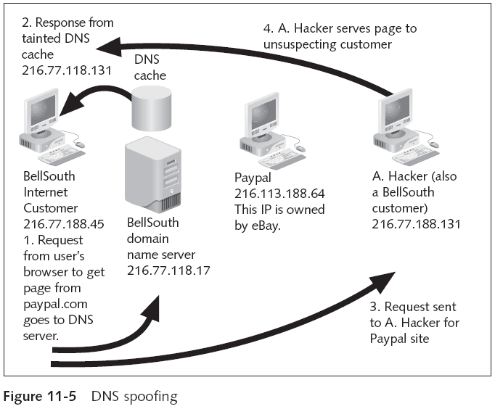
Computer Security and Penetration Testing

Slide 22
Software Attacks (continued)
Other software attacks include
  Teardrop
  Land
  Charge
Computer Security and Penetration Testing

Slide 23
Isolated Attacks
Comes from a single source
It is easily countered by blocking traffic from that source
Computer Security and Penetration Testing

Slide 24
Distributed Attacks
Come from multiple concurrent sources
Much more difficult to block with ACLs or firewall rules
Distributed denial-of-service, or DDoS, attack
  Depends on the hacker’s ability to compromise information on a large number of systems
  May require hundreds or thousands of compromised hosts to make a DDoS attack successful
  Special tools used to attack a computer
Computer Security and Penetration Testing

Slide 25
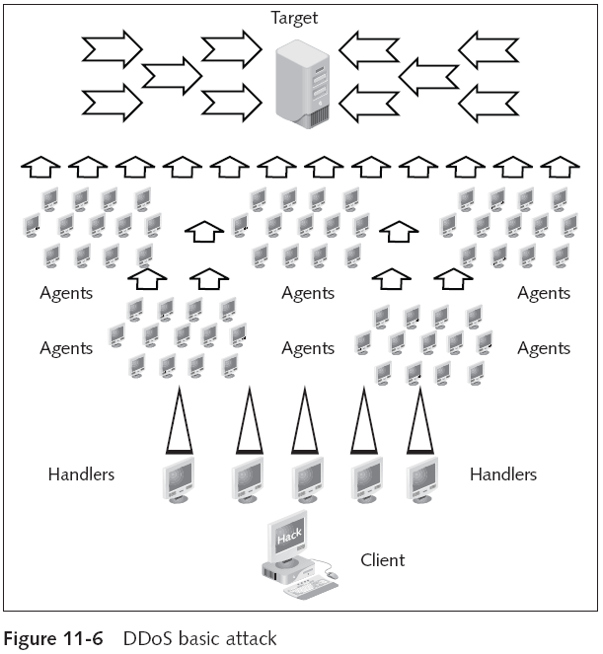
Computer Security and Penetration Testing

Slide 26
Distributed Attacks (continued)
The process of DDoS is fully automated
DDoS attack occurs in the following sequence:
  Hacker identifies vulnerable hosts (100 or more)
  Hacker gets access to these hosts after they are compromised
  Hacker installs the tool needed to attack each host
  Hacker uses the compromised hosts for future attacks
Computer Security and Penetration Testing

Slide 27
Known DoS Attacks
Some known flood attacks are TCP SYN, SMURF, and Fraggle
Denial of Service Database
  At http://attrition.org/security/denial/
  Has over 360 known DoS (and Ddos) exploits used on different targets
Computer Security and Penetration Testing

Slide 28
TCP SYN
TCP SYN attack
  Client and server exchange a sequence of messages after establishing a TCP connection
  Uses the familiar three-way handshake of TCP
Attacker establishes many half-connection
  Data structure in memory that holds all the pending half-connections increases in size
Hacker only has to use the IP spoofing technique to send excess SYN requests to the server
Computer Security and Penetration Testing

Slide 29
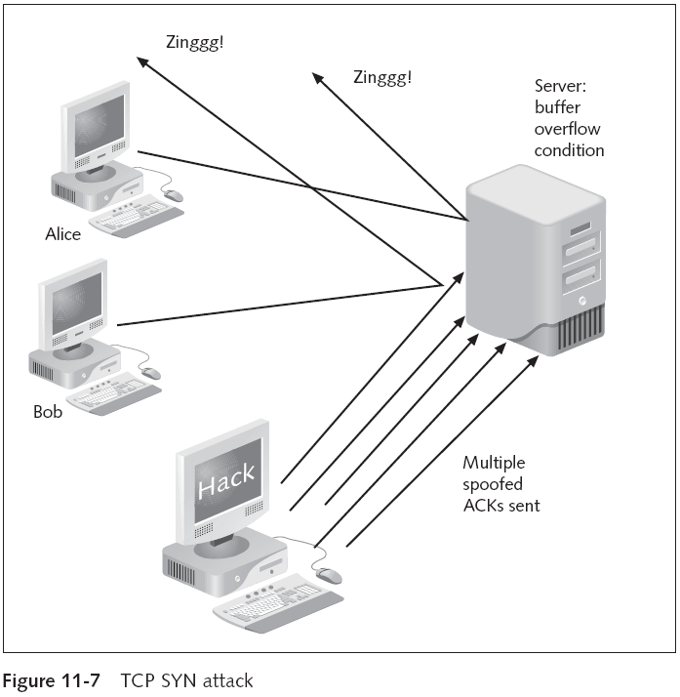
Computer Security and Penetration Testing

Slide 30
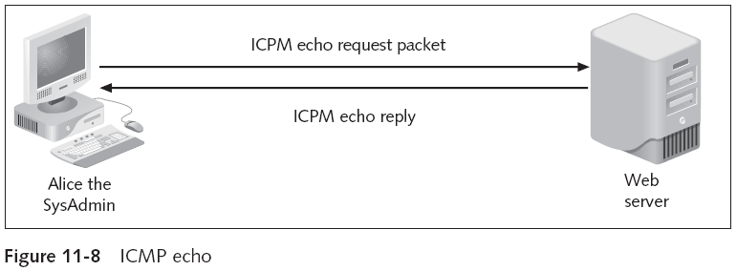
SMURF
ICMP is used to handle errors and exchange control messages on a network
ICMP process is executed using the ping command
Computer Security and Penetration Testing

Slide 31
SMURF (continued)
Main components involved in a SMURF attack
  Hacker, packet amplifiers or intermediate devices, and the target computer
Recently, automated tools have been developed
  That enable hackers to send these attacks simultaneously to several intermediaries
Computer Security and Penetration Testing

Slide 32
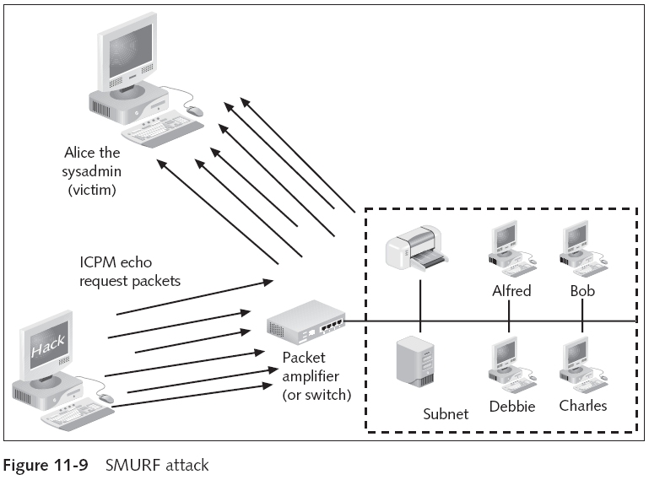
Computer Security and Penetration Testing

Slide 33
Fraggle
Fraggle attacks are like SMURF DoS attacks
  But use UDP packets
Attacker uses a spoofed IP address to broadcast hundreds of UDP packets across a network
Intermediate devices reply to the victim computer by sending hundreds of UDP echo reply packets
Best possible result is a system crash
  At the very least, the attack will produce excess network traffic
Computer Security and Penetration Testing

Slide 34
Known DDoS Attacks
DDoS tools use distributed technology to generate a large network of hosts
  Hosts can attack thousands of computers via packet flooding
Tools that can be used for DDoS attacks are Trinoo, Tribe flood network (TFN), and Botnets
Computer Security and Penetration Testing

Slide 35
Trinoo
Distributed tool used to initialize coordinated UDP flood DoS attacks from multiple sources
Trinoo network consists of a minute quantity of servers and a large number of clients
Hacker computer is connected to a Trinoo master computer in a DoS attack utilizing a Trinoo network
Hacker computer instructs the master computer to begin DoS attacks
  Against one or more IP addresses
Computer Security and Penetration Testing

Slide 36
TFN
Used to launch coordinated DoS flood attacks from multiple sources
TFN has the capability to create packets with spoofed source IP addresses
TFN network can generate DoS attacks such as:
  UDP flood attacks
  TCP SYN flood
  ICMP echo request flood
  ICMP directed broadcast
TFN follows the same principle as Trinoo
Computer Security and Penetration Testing

Slide 37
Botnets
Botnets
  A variety of software DDoS
A bot is a program that surreptitiously installs itself on a computer so it can be controlled by a hacker
A botnet is a network of robot, or zombie, computers
  Can harness their collective power to do damage
    Or send out huge amounts of junk e-mail
Computer Security and Penetration Testing

Slide 38
Prevention and Mitigation of DoS and DDoS Attacks
Network administrators can use packet filtering on the IP routers to give basic access control
This often slows router performance to an unacceptable point
Computer Security and Penetration Testing

Slide 39
Prevention Methods
Network Address Translation (NAT)
  Prevents DoS by
    Refusing network traffic from specific TCP ports
    Limiting the network traffic coming from specific network addresses
    Scanning the network traffic for viruses or undesirable applications
Solutions were designed to prevent DoS attacks on LANs and subnet systems
  Not meant for a Web environment
Computer Security and Penetration Testing

Slide 40
Prevention Methods (continued)
Cisco CSS 11000 series switches give comprehensive Web site and server-system security
Switches provide site-level safety as follows:
  DoS attack prevention
  Firewall security
  NAT
  Load-balancing
Computer Security and Penetration Testing

Slide 41
Prevention Methods (continued)
Other preventive measures
  Implement router filters or ingress filtering
  Computers should constantly be updated with the relevant security patches
  Use intrusion-detection systems on networks containing Web servers
  Disable any unnecessary services on your system
  If supported, enable quotas on the operating systems
Important to establish baselines for activities
Computer Security and Penetration Testing

Slide 42
Prevention Methods (continued)
Measures for preventing DDoS attacks:
  Filter all the RFC1918 address space by using access control lists (ACLs)
  Apply ingress and egress filtering using ACLs
  Rate-limit ICMP packets, if they are configurable
  Configure the rate limiting for SYN packets
Computer Security and Penetration Testing

Slide 43
Mitigation of DoS and DDoS Attacks
Use a tool such as Tripwire
  To detect changes in the configuration information or on other files
Problem with mitigation of DoS attacks
  Attacks are easily mistaken for a small spike in network activity
Upon detecting an attack
  Initiate blocking packets from the origin IP or to the victim
Computer Security and Penetration Testing

Slide 44
Mitigation of DoS and DDoS Attacks (continued)
Patch machines and applications
Stay current on new reports of DoS and DDoS attacks and systems
Run an IDS system that alerts you when the network is experiencing unusual traffic or activity
Computer Security and Penetration Testing

Slide 45
Summary
A denial-of-service attack is any network event that restricts or denies valid uses of a resource
DoS attacks are caused by
  Vulnerability of the network architecture
  Vulnerability of a specific server system architecture
  Defects and bugs in the operating system or software
  Holes present within system security
Three main groupings of DoS attacks: voluntary and involuntary attacks; flood and software attacks; and isolated and distributed attacks
Computer Security and Penetration Testing

Slide 46
Summary (continued)
Known DoS attacks: TCP SYN, SMURF, and Fraggle
DDoS attack tools include Trinoo, TFN, and Botnets
Methods of prevention for DoS attacks include
  Using Cisco CSS Web switches
  Implementing router filters or ingress filtering
  Constantly updating computers
  Monitoring the network to identify attack tools
  Disabling unnecessary system services
  Enabling quotas on the operating system
Computer Security and Penetration Testing

Slide 47
Summary (continued)
Methods of prevention for DDoS attacks include
  Filtering all the RFC1918 address space by using access control lists (ACLs)
  Applying ingress and egress filtering using ACLs
  Rate-limiting ICMP packets if they are configurable
  Configuring the rate limiting for SYN packets
Attempting to mitigate DoS and DDoS attacks can end up causing more harm than an actual attack
Computer Security and Penetration Testing

